Slide 2
Notes:
After the disaster of the M 6.7 San Fernando earthquake in 1971, the State of California began to enact statutes and policies to better protect its people from earthquake-related hazards. It established special study zones around the ground-surface trace of faults that are known to have caused surface rupture within the last ~11,000 years. Development within a special study zone requires a detailed site investigation by a geologist licensed in the State of California, and a plan that ensures that no habitable structures are built across an active fault.

Slide 3
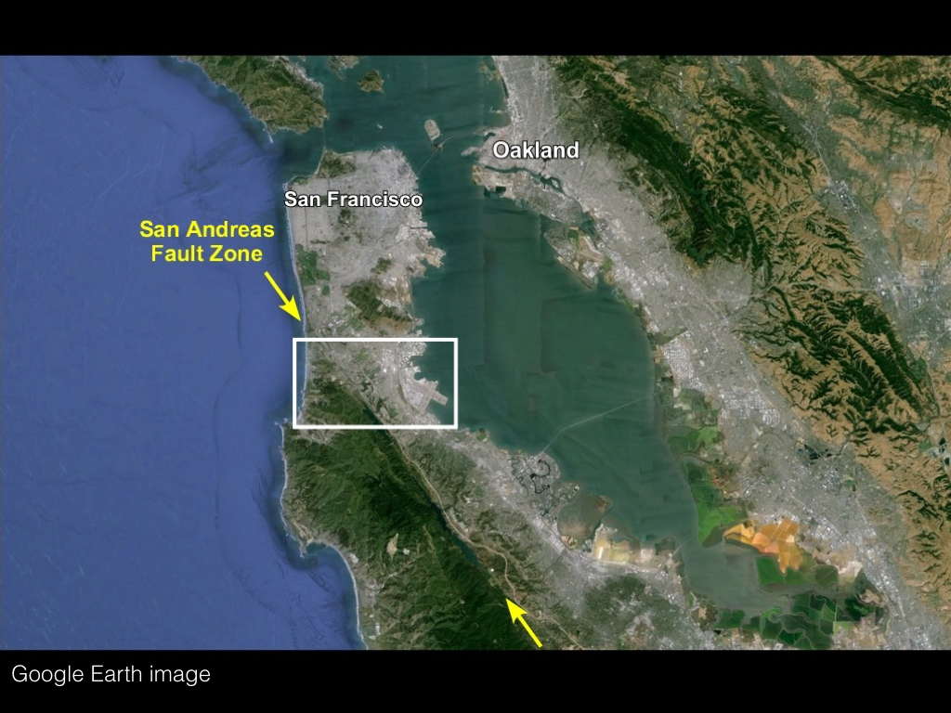
Notes:
The site for our case study is in the town of Pacifica, just south of San Francisco and within the San Andreas fault zone. The next image will span the area in the white rectangle.

Slide 4
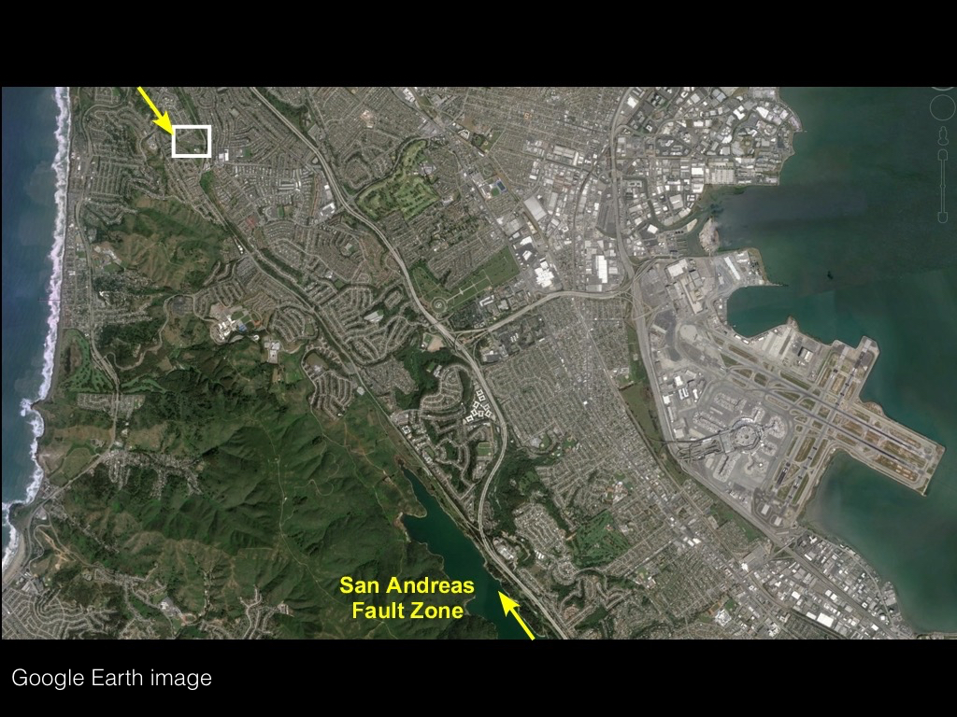
Notes:
The site maps and images that follow will depict the area in the white rectangle, which is along the San Andreas fault zone. The San Francisco International Airport is show at right, and San Andreas Lake is at the middle bottom of the image. The San Andreas fault was named after San Andreas Lake.

Slide 5
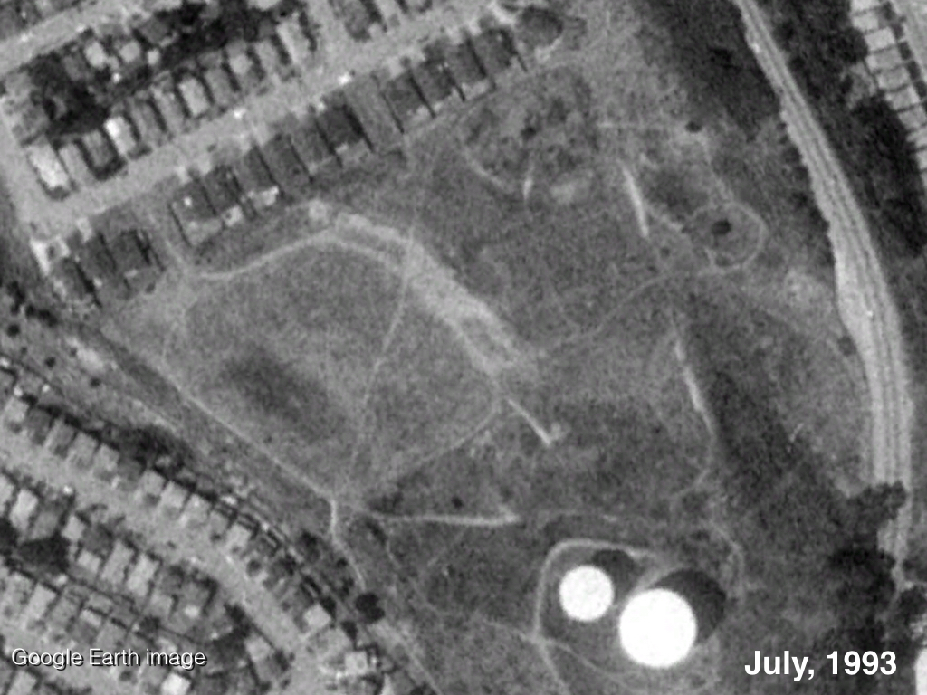
Notes:
A small area within this commuter town had not been developed before the 1971 San Fernando earthquake, but houses were legally placed directly on or across the ground-surface trace of the active San Andreas fault during earlier development phases. The demand for housing in this area is high, because it is easy commuting distance to the entire San Francisco peninsula.
In the 1990s, a developer wanted to build houses on a small undeveloped area within the special study zone of the San Andreas Fault in an area that experienced ~4 m of right-lateral shear during a single M ~7.8 earthquake in 1906 (Lawson and others, 1906).

Slide 6
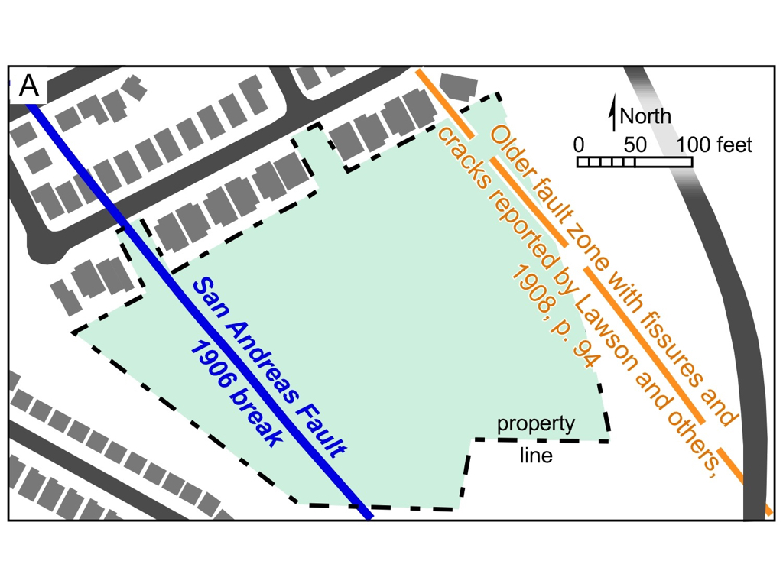
Notes:
Prior to development, the location of historic fault displacements was known based on mapping after the 1906 earthquake (Lawson and others, 1906; Gilbert, 1906). The developer’s consulting geoscientists surveyed historical records and designed an investigation to locate fault traces within the property.

Slide 7
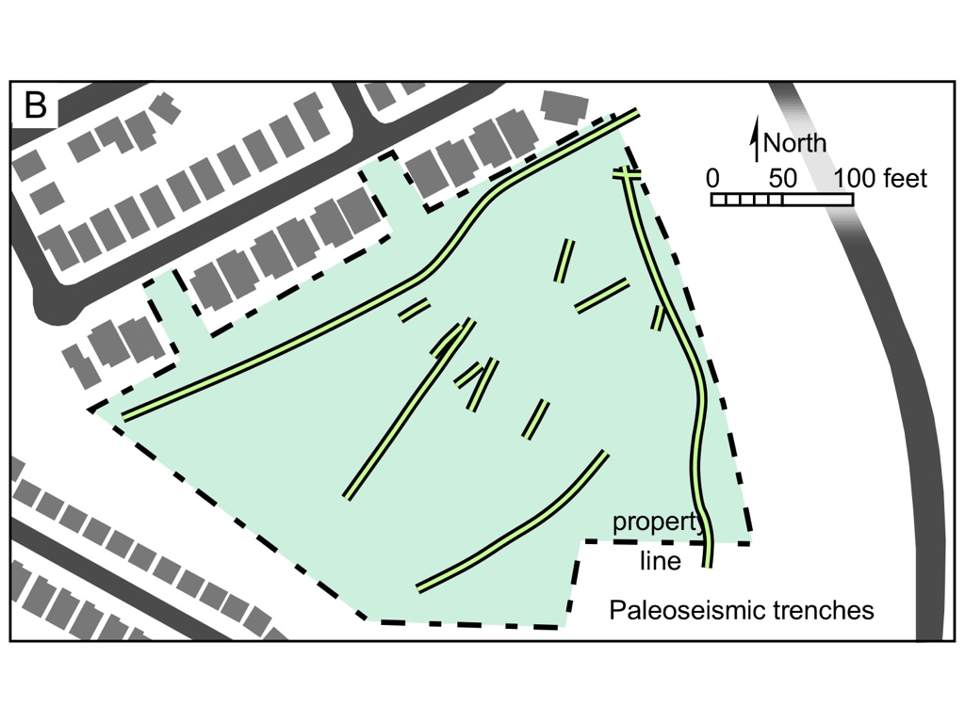
Notes:
The consultants established trenches across suspected fault traces.

Slide 8
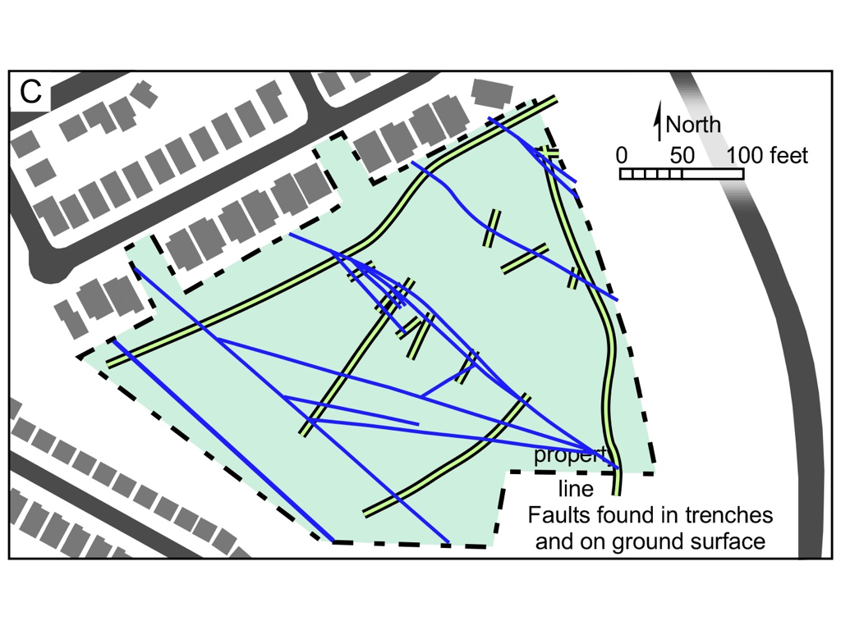
Notes:
They located the main active fault trace of the San Andreas fault, as well as several other less prominent fault splays.

Slide 9
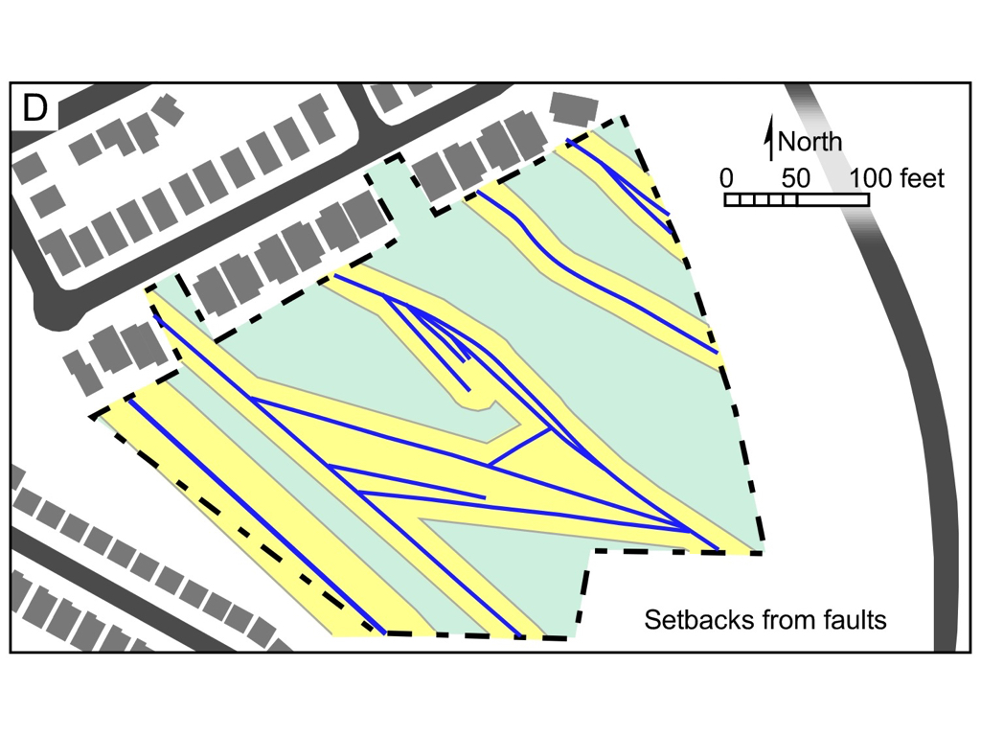
Notes:
A design was developed that <slide 18> established a ~15 meter setback from the mapped main trace, and a ~ 9 meter setback from the minor splays.

Slide 10
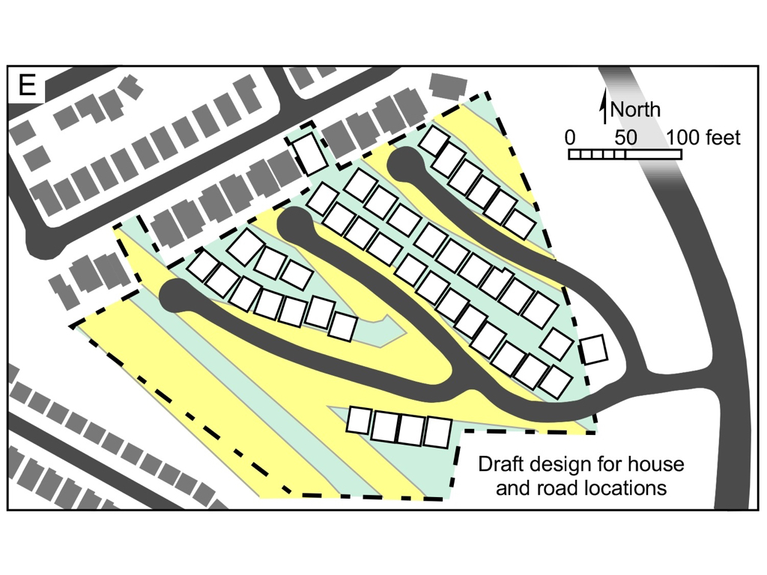
Notes:
Using the average size of other houses in the area as a guide, the developer created a design that maximized the number of new houses that could be built on the property without intruding on the setback zones around the fault traces. The access roads were all located along the faults, and all of the utility lines (gas, water, sewer, electricity, telecommunications) were buried under the roadways. The design could be implemented profitably, met all legal requirements, and was submitted for review and approval by the appropriate regulatory agencies.

Slide 11
Notes:
Given the preceding information, imagine that you are a member of the local planning commission. It is your responsibility to act rationally in light of all of the facts and governing laws, and to make decisions that are in the best interests of the public that you serve. Think about this proposal. What are its “pros” and “cons” relative to the public interest. Decide how you would vote on this proposal, and why you would vote that way.
Then pair up with one or two students near you, and share your views on this proposal. Finally, use the form provided to commit to an initial vote, and to explain your reasons. You have five minutes to do this.

Slide 12
Notes:
A magnitude 6 earthquake occurred on August 24, 2014, with an epicenter about 65 km (40 miles) northeast of the proposed development site. While nobody was killed in this earthquake, it caused an estimated 400 million dollars in damage, particularly in Napa and surrounding communities.

Slide 13
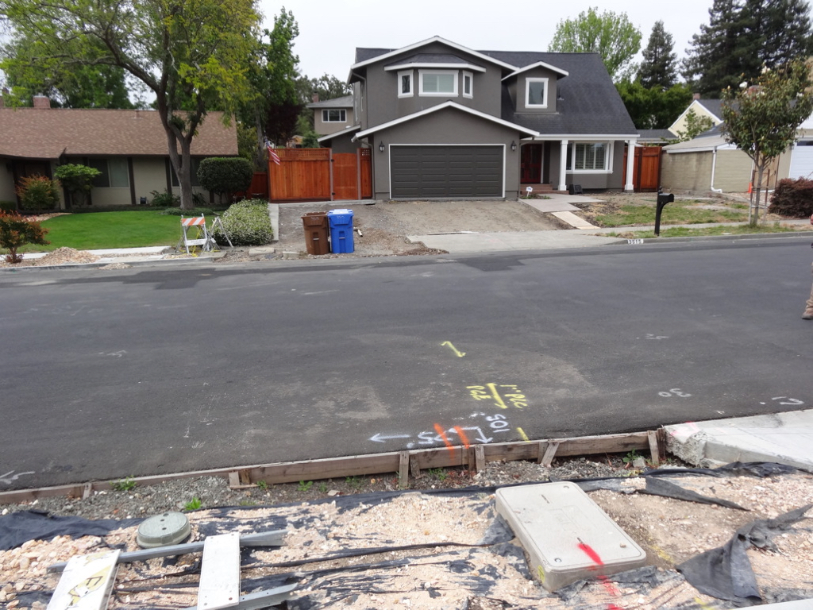
Notes:
In the Browns Valley subdivision near Napa, the utilities were buried under the roadways. In many locations along the West Napa fault, those utility lines were badly damaged and had to be repaired or replaced. The gray house in this photo was badly damaged and required extensive repairs, including a new foundation.

Slide 14
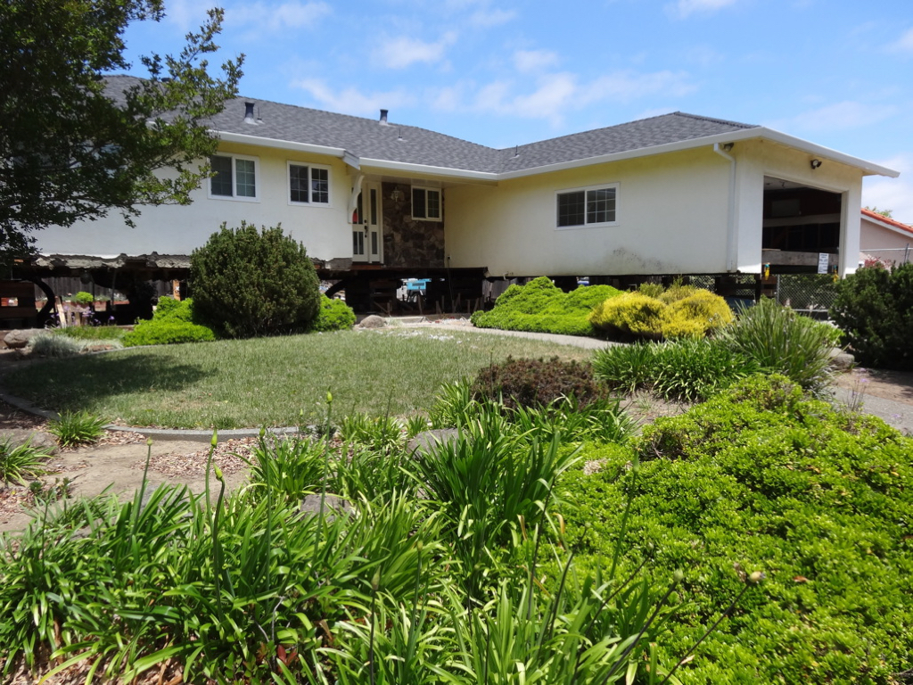
Notes:
Many houses in the area suffered major foundation damage, and had to be lifted like this house so that a new foundation could be constructed under the house.

Slide 15
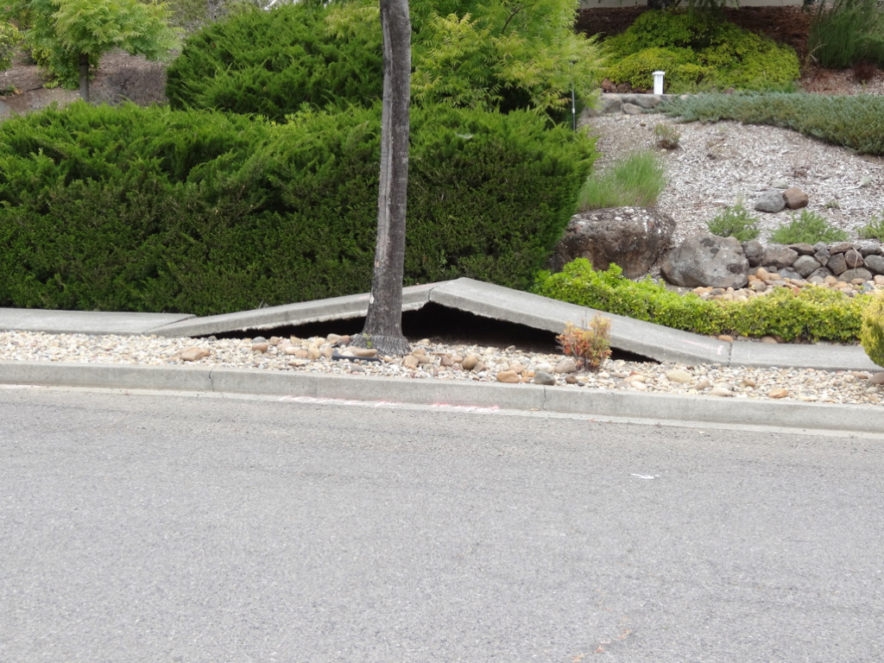
Notes:
Throughout the Napa area, roads and curbs were damaged, and sidewalks were buckled into tent-like structures.

Slide 16
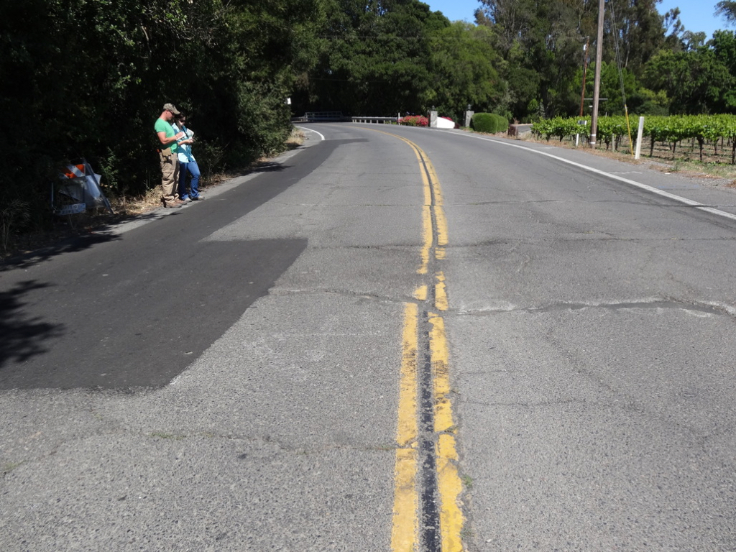
Notes:
To the south of Napa in the epicentral area, the fault crossed roadways whose center lines were displaced in a right-lateral sense during the earthquake. Along this road, there were several fault splays that showed displacement.

Slide 17
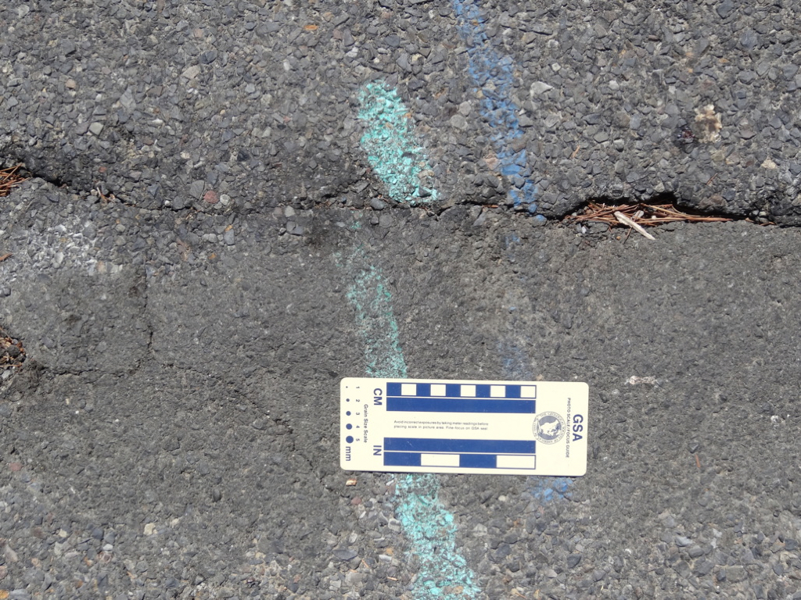
Notes:
After the main shock on August 24, geoscientists sprayed paint in lines across the fault traces. The displaced paint lines show that the fault continued to slip after the main earthquake.

Slide 18
Notes:
On April 25, 2015, a magnitude 7.8 earthquake occurred on a thrust fault in Nepal, causing more than 9,000 deaths. Many people were buried in landslides and rock falls in areas where there was no accurate census prior to the earthquake, so we will never know how many people died here.

Slide 19
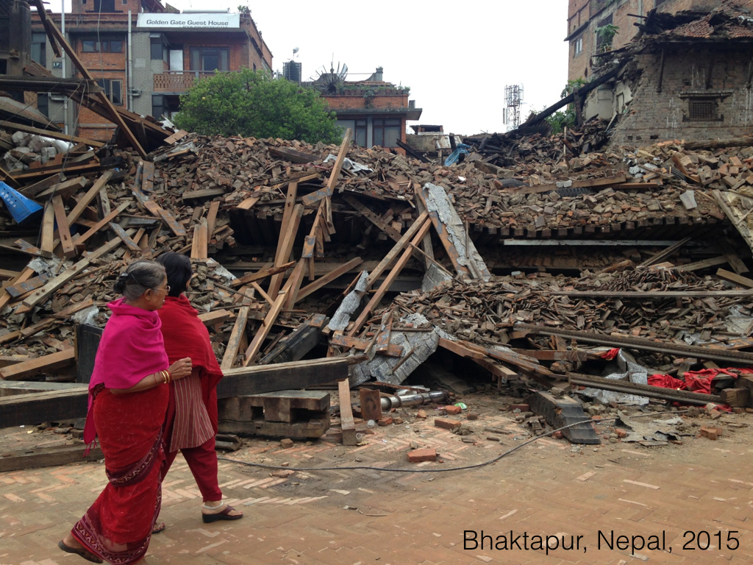
Notes:
The devastation was captured in countless videos and photographs that you can find on the web. This earthquake occurred on one of the thrust faults that is involved with the uplift of the Himalayan range, rather than along a strike-slip fault like the San Andreas fault. The magnitude of the earthquake was about the same as the 1906 San Francisco earthquake.

Slide 20
Notes:
San Francisco was a major city in 1906 – probably the largest city west of St. Louis. Still, the overall area was lightly populated. The San Francisco earthquake of 1906 was a magnitude ~7.8-8.3 event along the San Andreas fault, and it caused an estimated 3000 deaths. The downtown area of the city was largely destroyed through a combination of the earthquake and fires accelerated by broken natural gas lines. The US Army actually had to demolish intact buildings to create a fire break, so that the fire would not continue to spread south along the peninsula. Current estimates of the total damage are in the neighborhood of 10.5 billion dollars, in 2015 dollars.
In the area of the proposed development, the total displacement across the San Andreas was about 12 feet or ~4 m, according to Lawson and others (1906).

Slide 21
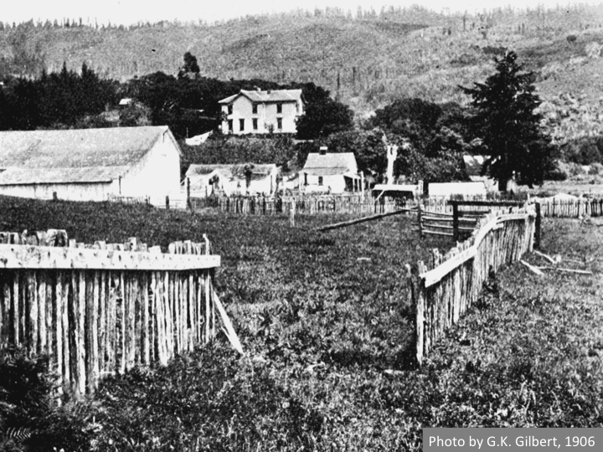
Notes:
This was the first well-documented major earthquake in the US. Teams of geologists from universities, the State of California, and the US Geological Survey spread out across the affected area and photographed much of the damage. This fence was torn in two by slip along the San Andreas fault. This photo was taken ~0.8 km north of Woodville, California, near Point Reyes by Grove Karl Gilbert of the USGS. It shows 8.5 feet of right-lateral displacement.
https://en.wikisource.org/wiki/Popular_Science_Monthly/Volume_69/August_1906/The_Investigation_of_the_San_Francisco_Earthquake#/media/File:PSM_V69_D106_Land_separated_by_the_earthquake_fault.png

Slide 22
Notes:
About 4 meters of displacement occurred in the area of the proposed development in 1906. This part of the San Andreas fault is thought to be very likely to produce another major earthquake in the next hundred years or so.

Slide 23
Notes:
Now that you have the benefit of a little bit more information, repeat your deliberation about whether you would approve this proposed development if you were a member of the relevant planning commission. Share your ideas with someone nearby, and commit your decisions to writing as before. You have three minutes.

Slide 24
Notes:
Here is the project as proposed. In real life, the proposal was considered by various public committees…

Slide 25
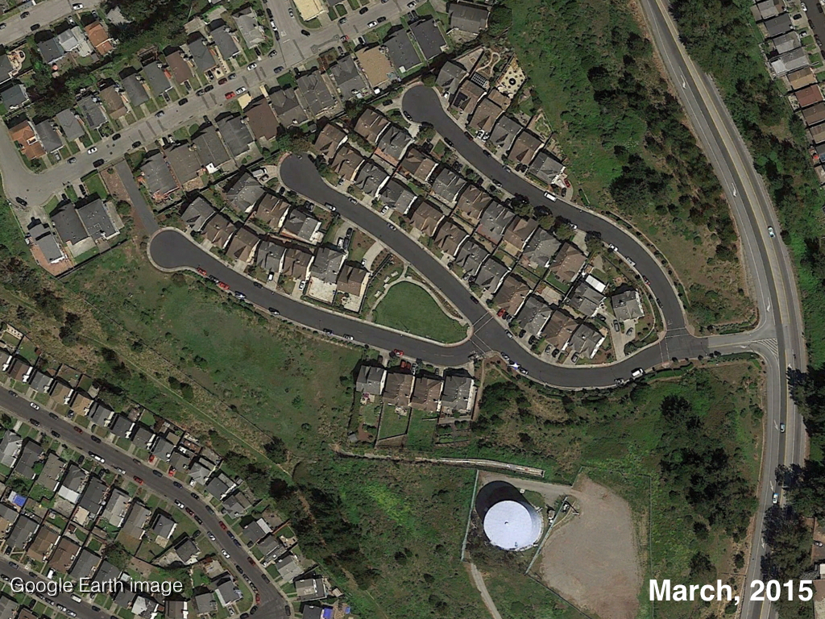
Notes:
… who approved the plan because it met all of the legal requirements for a new residential development. And so the development was built as designed.

Slide 26
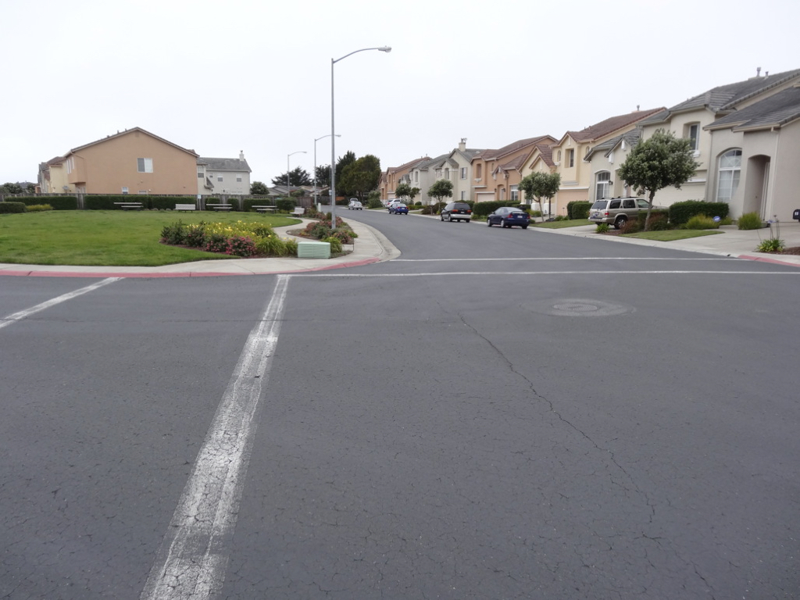
Notes:
This is what it looks like.

Slide 27
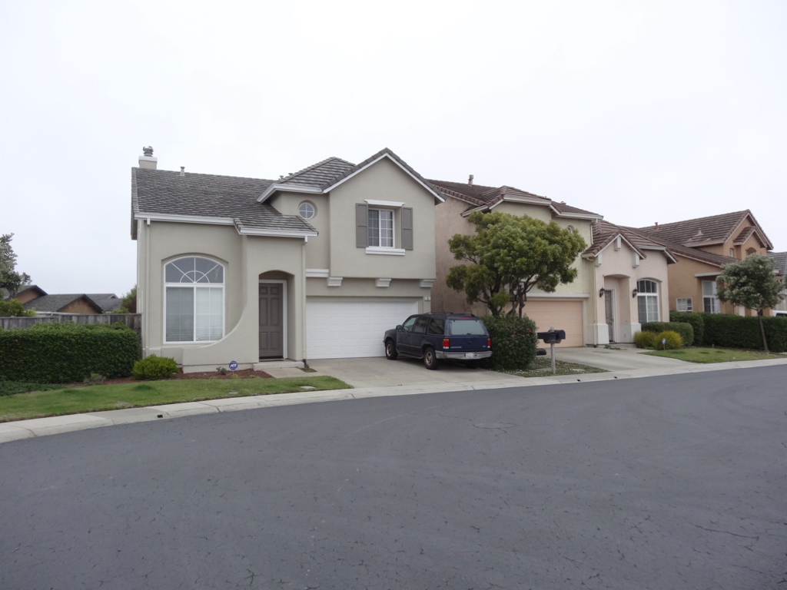
Notes:
A brief visit in the summer of 2015 indicated that all of these houses have been sold, and families now live in them.

Slide 28
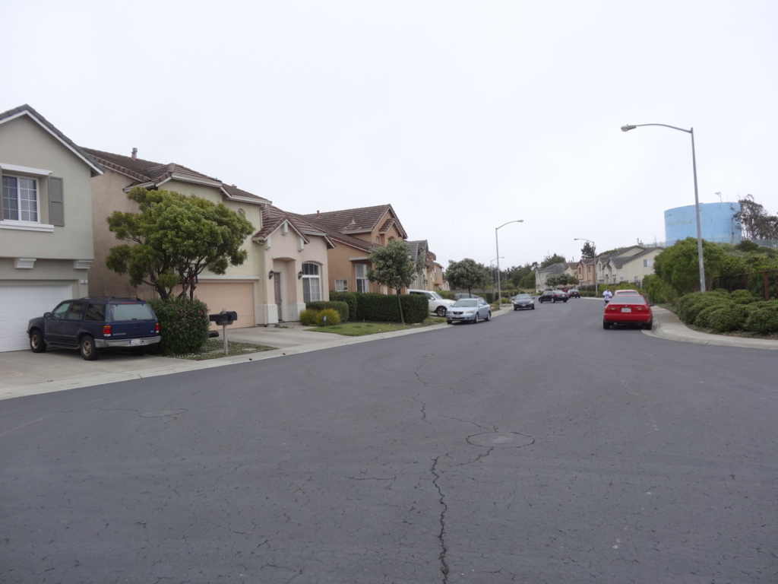
Notes:
The development looks very nice, and the location is great in terms of getting around the peninsula. The crack in the new asphalt concrete street roughly coincides with one of the fault traces mapped by the developer’s consultants.

Slide 29
Notes:
What do you think are the ethical issues related to this case?

Slide 30
