Slide 1
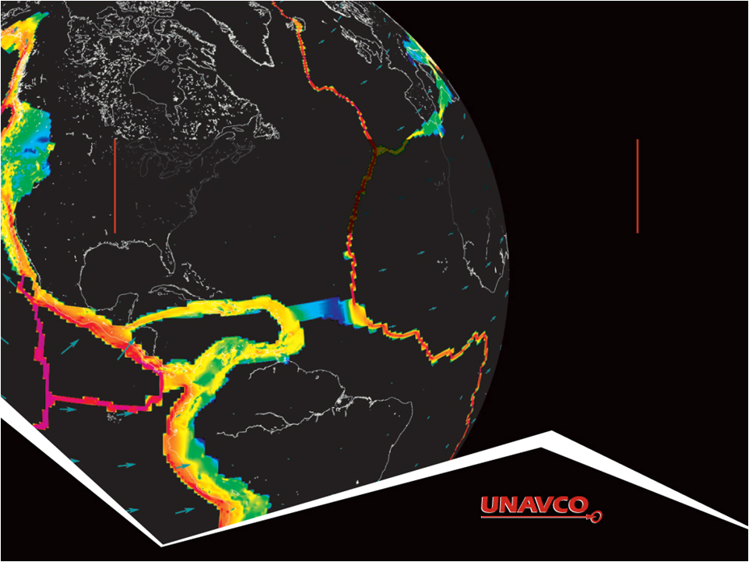
Introduction to GPS/GNSS Basics
Vince Cronin (Baylor University) & Shelley Olds (UNAVCO)
Revisions by Beth Pratt-Sitaula (UNAVCO)
Version January 2017
Notes:
This slideshow goes over the basics of how the global positioning system (GPS) works.
Although the term GPS (Global Positioning System) is more commonly used in everyday language, it officially refers only to the USA's constellation of satellites. GNSS (Global Navigation Satellite System) is a universal term that refers to all satellite navigation systems including those from the USA (GPS), Russia (GLONASS), European Union (Galileo), China (BeiDou), and others.
In this module, we use the term GPS even though, technically, some of the data may be coming from satellites in other systems.
Image from UNAVCO
Questions or comments please education AT unavco.org

Slide 2
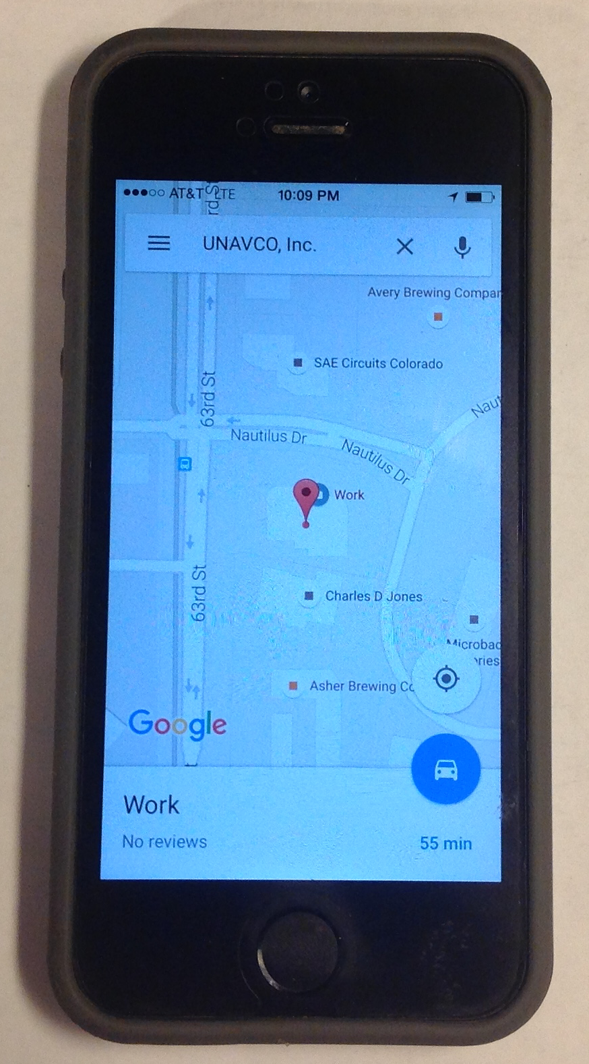
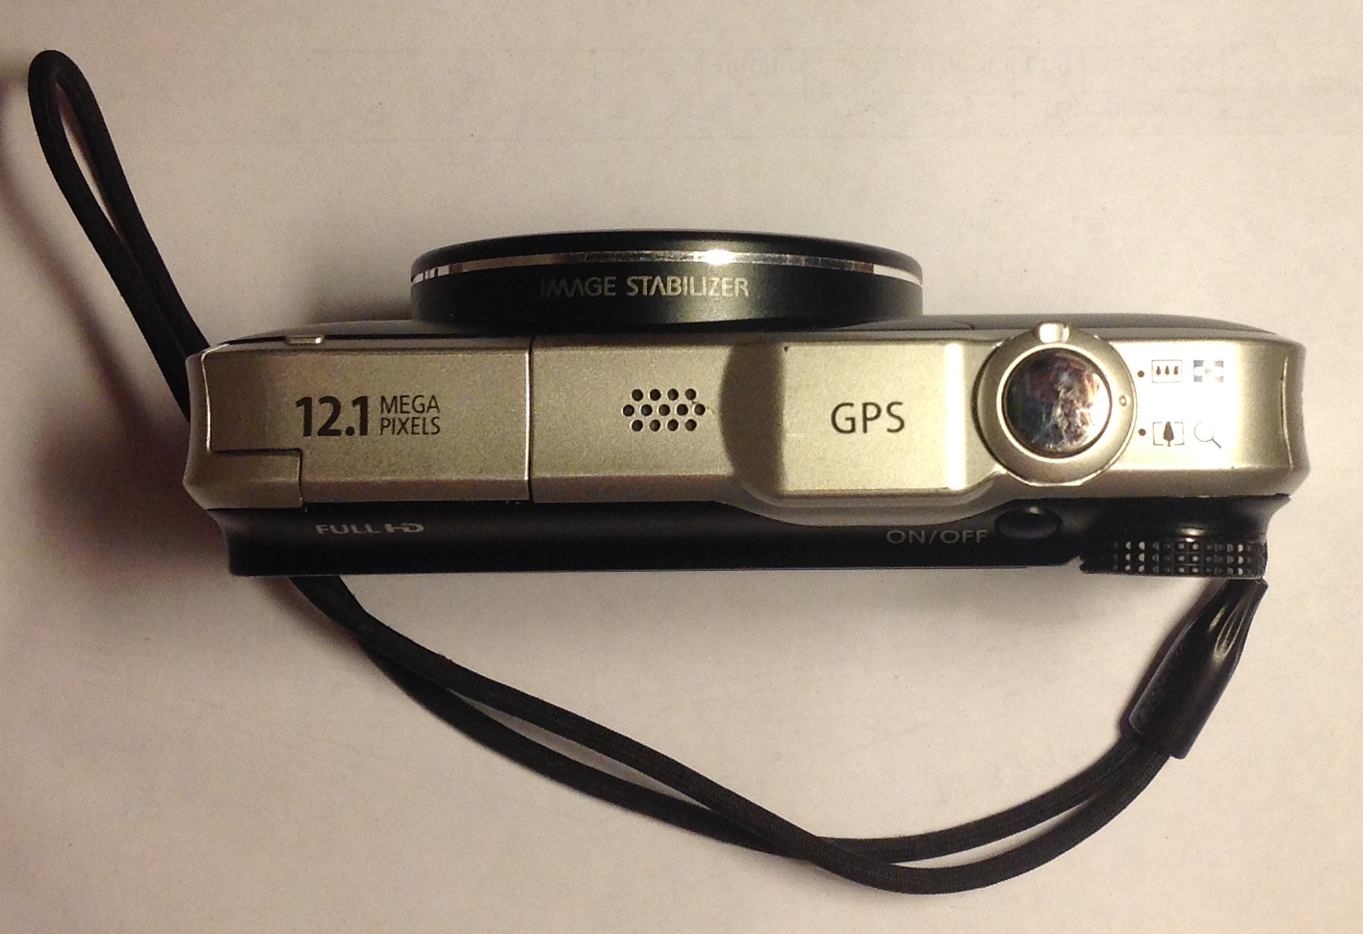
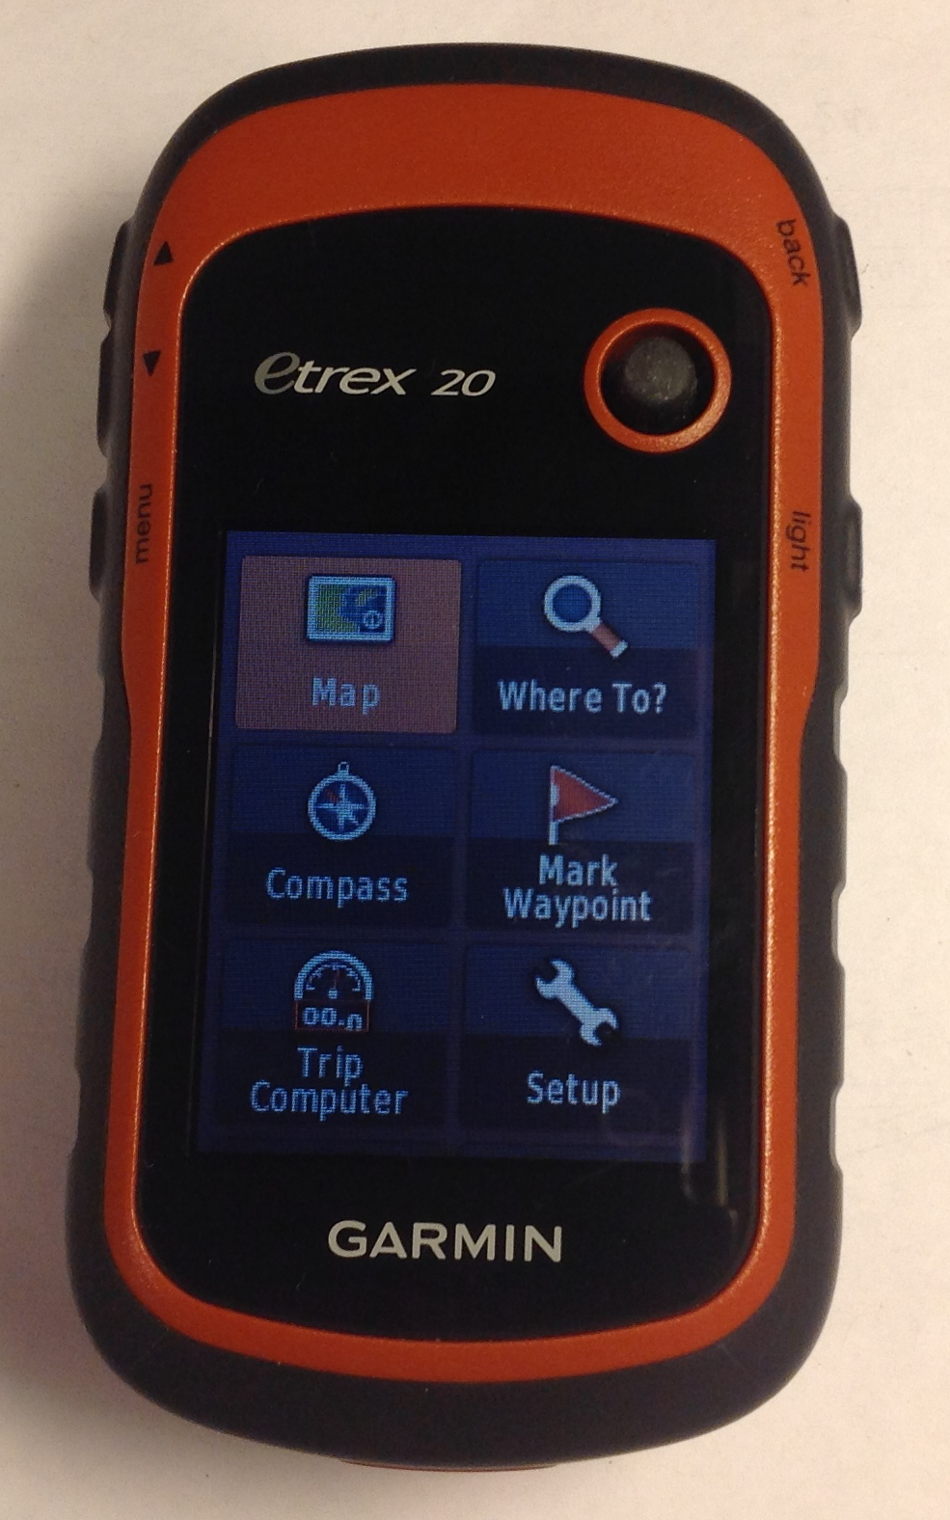
GPS receivers all around us
Notes:
Whether they know it or not, students use GPS receivers daily in their cars, phones, cameras, and handheld recreational GPS. Most have heard the term “GPS” but few know much about how the system actually works or high precision GPS for science and industrial use.
Images from UNAVCO

Slide 3
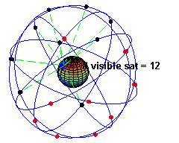
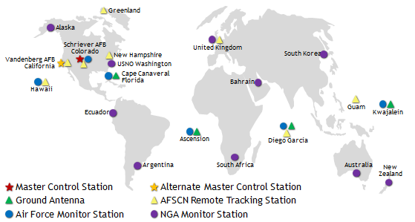
The Global Positioning System
24-32 satellites
20,200 km altitude
55 degrees inclination
12 hour orbital period
Need 4 satellites to be accurate
Ground control stations
Each satellite passes over a ground monitoring station every 12 hours
Notes:
From the users point of view, GPS is a passive system: you need only a low-powered receiver to obtain the signals, which contain all the information you need to determine your position. This requires that the satellites carry atomic clocks to keep accurate time and transmit to the user the position of the satellite in the sky. The orbits are computed by Department of Defense (DoD) by tracking the satellites from ground control stations. GPS control segment consists of a global network of ground facilities that track the GPS satellites, monitor their transmissions, perform analyses, and send commands and data to the constellation. The current (as of 2015) operational control segment includes a master control station, an alternate master control station, 12 command and control antennas, and 16 monitoring sites. The ground control stations have known positions and then uploaded to the satellites which then transmit the information continuously along with the time. With hand-held receivers, it is possible to find your position to a few meters, limited primarily by the accuracy of the broadcast orbits. As we shall see, the civilian scientific community uses over 200 stations to determine the orbits with an accuracy of a few centimeters, allowing millimeter positioning with after several hours of tracking.
Upper image: https://en.wikipedia.org/wiki/Global_Positioning_System
Lower image: http://www.gps.gov/systems/gps/control/ (public domain)

Slide 4

GPS Satellite
Artist’s conception of a GPS Block II-F satellite in Earth orbit. (public domain from NASA)
Notes:
https://en.wikipedia.org/wiki/Global_Positioning_System

Slide 5
Ground control stations
The tracking information from the monitoring stations is sent to the Air Force Space Command, which is operated by the 2nd Space Operations Squadron (2 SOPS) of the US Air Force.
2 SOPS contacts each GPS satellite regularly with a navigational update using the dedicated ground antennas.
These updates synchronize the atomic clocks on the satellites to within a few nanoseconds of each other, and adjust the ephemeris of each satellite's internal orbital model.
http://en.wikipedia.org/wiki/Global_Positioning_System

Slide 6
Almanac & Ephemeris data
GPS satellites include almanac and ephemeris data in the signals they transmit
Almanac data are coarse orbital parameters for all GPS satellites
Ephemeris data are very precise orbital and clock correction for that particular GPS satellite--necessary for precise positioning
Notes:
A receiver that has recently (last several months) downloaded almanac data will know which satellites to expect in the sky for a given region and time. It helps a receiver “lock” into the satellite constellation more quickly. Think of the almanac as a catalog with general locations for all the GPS satellites
Ephemeris data is critical to precise positioning. When ephemeris data is encrypted (selective availability), real-time GPS positions become significantly less accurate. In all cases ephemeris data can be obtained several weeks later so that non-real time applications can achieve full accuracy. Each satellite only broadcasts its own ephemeris data.
Information from http://gpsinformation.net/main/almanac.txt

Slide 7
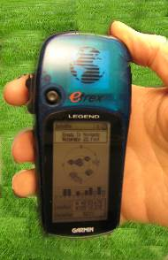
Consumer-grade GPS accuracy
Horizontal: +/- 10 m (30 ft) error
Vertical: +/- 15 m (45 ft) error
Your location is:
37º 23.323’ N
122º 02.162’ W
Notes:
Since each satellite maintains time very accurately (~1 nanosecond = 30 cm), it can tag its signal with the time of transmission. This information, together with the location of the satellite, also transmitted to the receiver, is sufficient to allow the receiver to calculate the range to each satellite provided that the receiver also knows also knows the time. Equipping receivers with atomic clocks would be very expensive, so the receiver tags the signal with the time of its internal clock to create a “pseudorange” (range plus an unknown clock correction). The software in the receiver than uses the pseudoranges from four satellites to solve for the four unknowns: three coordinates and the receiver clock correction.
Image by Vince Cronin (Baylor University)

Slide 8
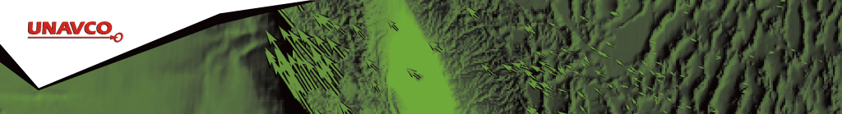
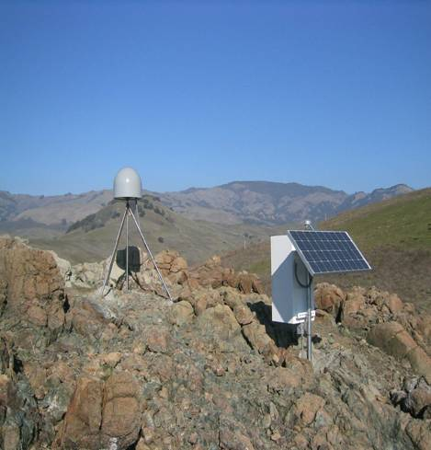
Anatomy of a High-precision Permanent GPS Station
GPS antenna inside of dome
Monument solidly attached into the ground with braces.
If the ground moves, the station moves.
Solar panel for power
Equipment enclosure
GPS receiver
Power/batteries
Communications/ radio/ modem
Data storage/ memory
Notes:
Example of a typical remote GPS station. In urban areas, some are also fixed to the roof of large reinforced buildings and hooked into grid power supply with battery backup. Many stations are now being equipped with “real time” communication to allow immediate transfer of data to researchers. In other places logistics or country-specific regulations require that data not be transmitted but is instead downloaded manually on a given schedule (monthly, quarterly, annually depending on the site)
Image from UNAVCO

Slide 9
High-precision GPS
Good monuments
Multiple stations
Sophisticated processing software
Collect lots of data
Current accuracies sub-cm.
Use the carrier phase
Dual-frequency receivers
High-precision orbital information (ephemeris)
Notes:
The primary GPS signal is transmitted at a “carrier’ frequency of 1575 MHz (“L-band”), corresponding to a wavelength of 19 cm. As with FM radio, This signal is then modulated at a much lower frequency to each modulated to incorporate information about the time and location of the satellites. The precision of the pseudorange is limited by the modulation frequency to about 10 cm. In high-precision GPS we use the carrier phase itself to obtain a measurement precision of 10 cm
Simple GPS receivers use code-phase to determine locations to an accuracy of 3-6 meters. Essentially code-phase is bigger chunks of signal. High precision receivers use the carrier phase of the signal. You can think of this is being able to line up smaller chucks of code between the satellite and the receiver. This leads to smaller errors and more precise locations. Trimble has a more full explanation of the difference (http://www.trimble.com/gps_tutorial/sub_phases.aspx).
Duel-frequency receivers can “tune in to” the satellite signal at more than one frequency. You can think of this as listening to more than one radio station at the same time. In the case of GPS, this can allow for reduction in error from the ionosphere delays.

Slide 10
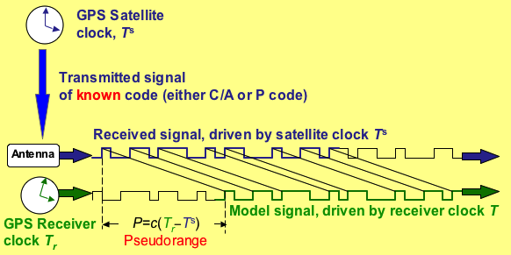
How satellite-receiver distance is measured
Radio signal from satellite tells GPS receiver the satellite-clock time and provides the most recent corrections to the satellite’s position relative to Earth (ephemeris)
GPS receiver compares the satellite-times to receiver-time to determine the distance to each satellite
Notes:
Image by Vince Cronin (Baylor University)

Slide 11
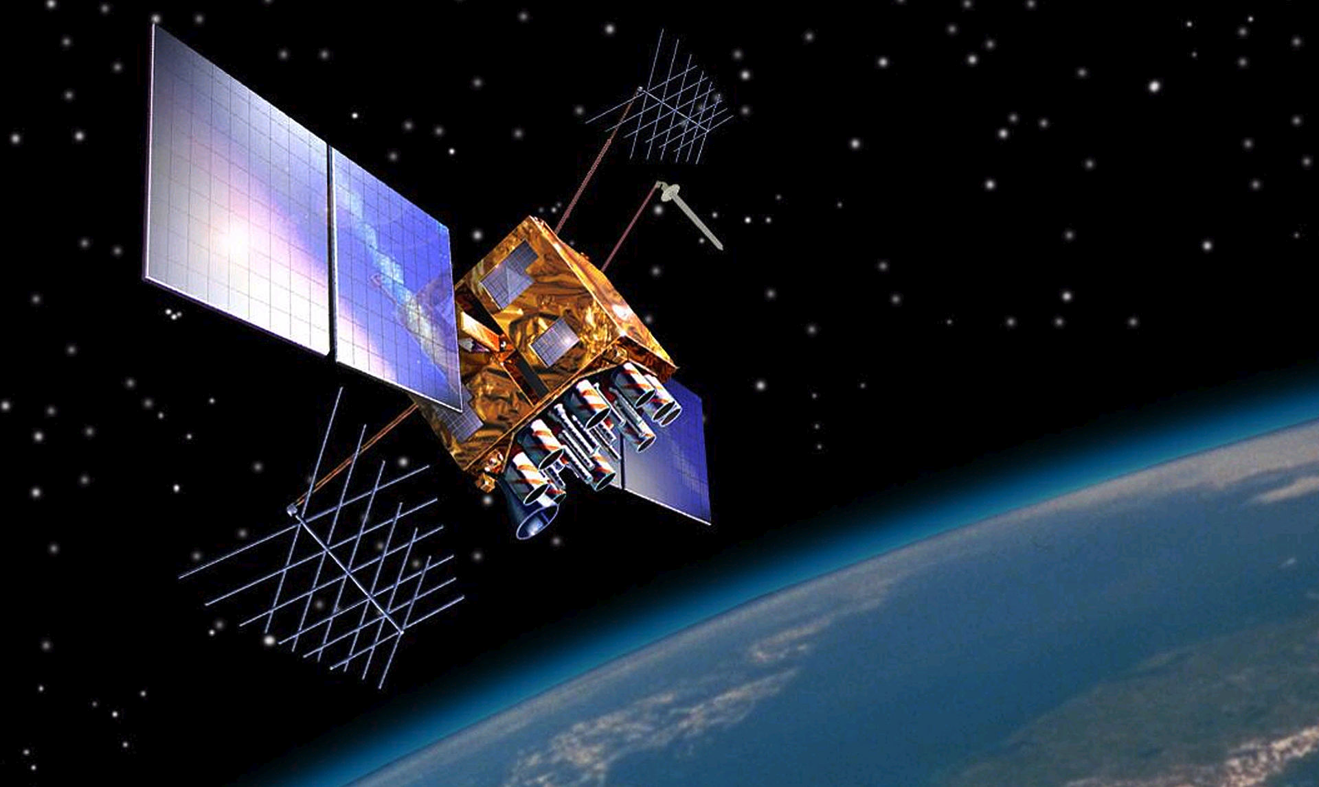
GPS & atomic clocks
Each GPS satellite has 4 atomic clocks, to be sure that one is always working. Each costs ~$100,000, and is accurate to 1 billionth of a second (1 nanosecond).
Notes:
GPS depends on extremely accurate time-keeping, so the very best clocks must be used.
Image by US Government - US National Executive Committee for Space-Based Positioning, Navigation and Timing, Public Domain, https://commons.wikimedia.org/w/index.php?curid=7567464

Slide 12
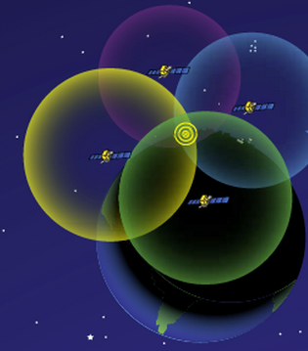
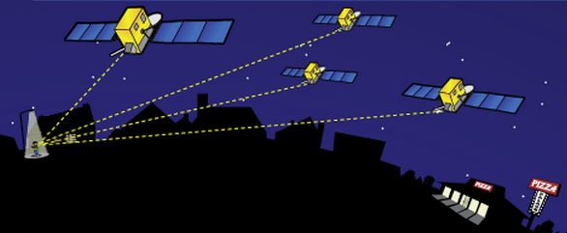
How actual location is determined
http://spaceplace.nasa.gov/gps-pizza/en/
Antenna position is determined by calculating the distances to at least 4 satellites. This enables the solving for four variables: x, y, z and time using trilateration.
Notes:
The time element is needed because of the difference between the highly accurate atomic clock on the satellites ($100,000 each) and the much-cheaper clock in the GPS receivers.
Although 4 is a technical minimum number of satellites, for geoscience research work it is highly recommended to have at least 6 satellites.
Although people will often refer to this process and “triangulation” in fact it is “trilateration” because it depends on distances rather than angles.
For a nice explanation of trilateration versus triangulation visit https://gisgeography.com/trilateration-triangulation-gps/.
Images from NASA (public domain) http://spaceplace.nasa.gov/gps-pizza/en/

Slide 13
Sources of Error
Some GPS Error Sources
Selective Availability (ephemeris data encrypted by military – turned off in 2000)
Satellite orbit irregularities
Satellite and receiver clock errors
Atmospheric delays – speed of light is affected by water content and other variables in the atmosphere
Multi-path – GPS signals can bounce off the ground and then enter the antenna, rather than only entering from above only
Human errors
Notes:
There is a complex field of engineering and science behind post-processing GPS data to reduce error sources.
In addition to those mentioned above, specific sites may measure movements not associated with the parameter the researcher wants to measure. For instance
Seasonal ground water fluctuations may cause the ground to rise and fall annually, in a way that is not related to plate motion at all.
A site could be sliding downhill because of a creeping landslide.
A melting glacier or a falling lakes level will “unweight” and area leading to rebound and upward movement measured by the GPS
It is best to collect multiple years of data before trying to draw conclusions.

Slide 14
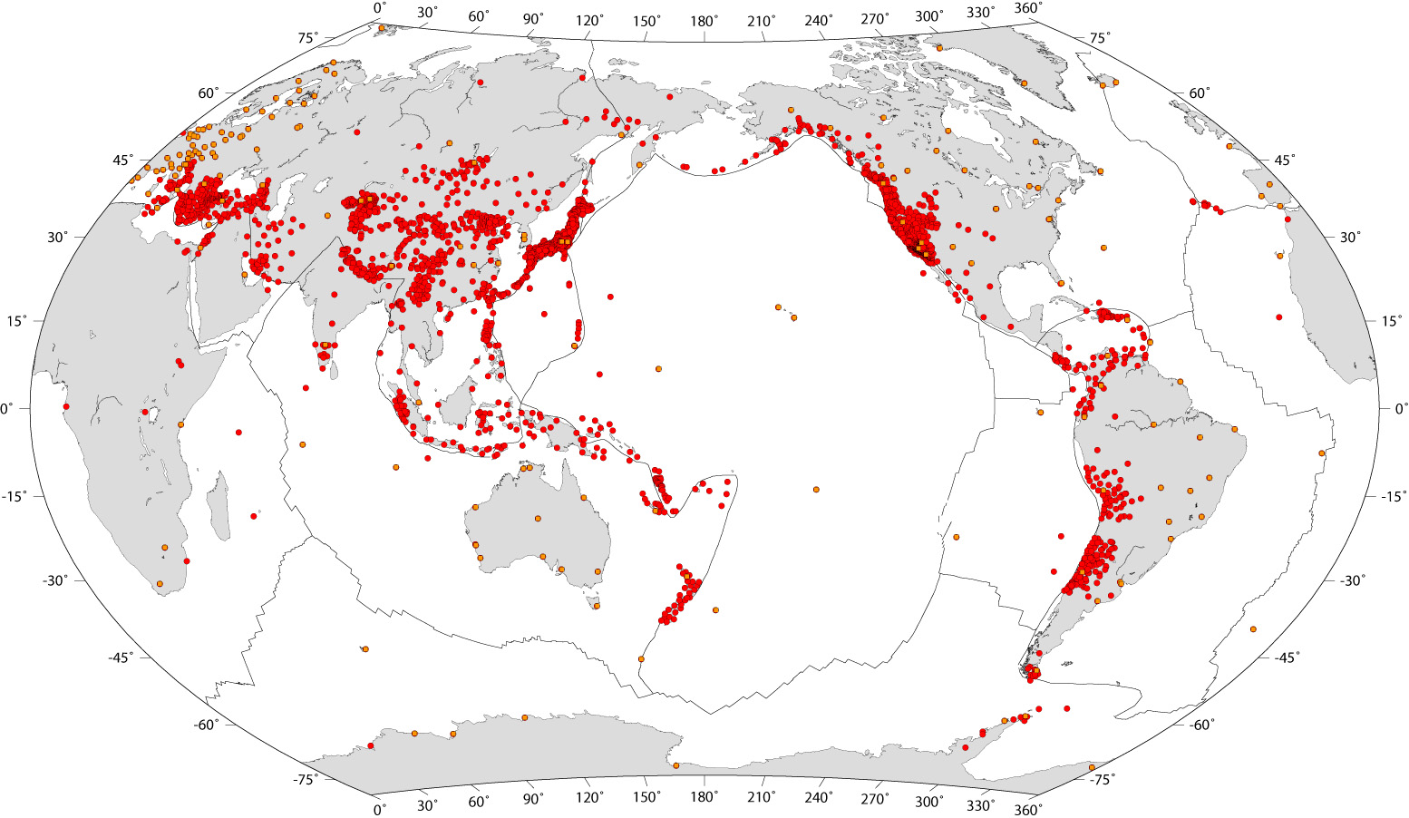
GNSS/GPS stations globally
>10,000 stations with more added all the time
Some data freely available, some not
GNSS = Global Navigation Satellite System
Notes:
Although the term GPS (Global Positioning System) is more commonly used in everyday language, it officially refers only to the USA's constellation of satellites. GNSS (Global Navigation Satellite System) is a universal term that refers to all satellite navigation systems including those from the USA (GPS), Russia (GLONASS), European Union (Galileo), China (BeiDou), and others.
In this module, we use the term GPS even though, technically, some of the data may be coming from satellites in other systems.
Image from http://gsrm.unavco.org/data/images/1.2/sites.jpg

Slide 15
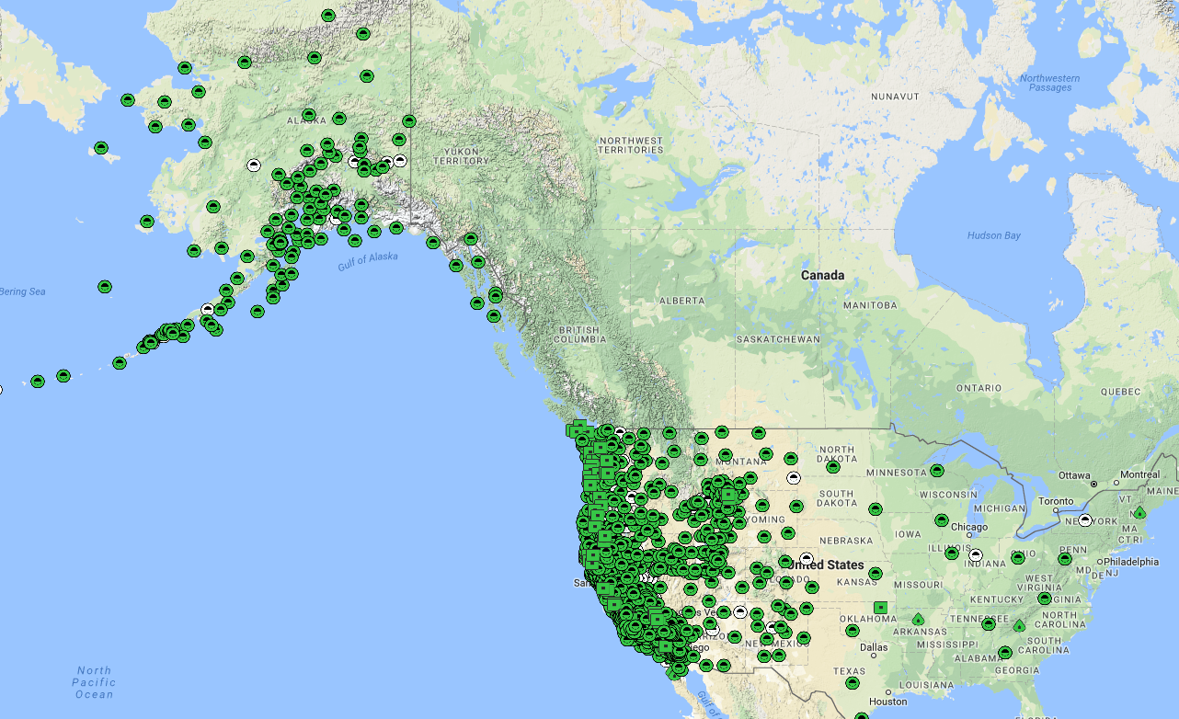


Plate Boundary Observatory (PBO)
PBO involves installation, operation and maintenance of >1100 continuously operating high-precision GPS stations (plus >170 other instruments: strainmeters, borehole seismometers and tiltmeters)
http://www.unavco.org/instrumentation/networks/status/pbo
Notes:
Plate Boundary Observatory (PBO) is a major component of the large geophysics initiative, EarthScope. It is run by UNAVCO, a non-profit university-governed consortium dedicated to providing geodetic support to the research and educational communities. The PBO GPS stations are located throughout the USA states, territories, and a few other places around the world but the highest concentration of stations is in the actively deforming western USA and southern Alaska. PBO is the biggest GPS network in the USA and one of the biggest (if not the biggest) in the world.
All data from PBO (raw and processed) is freely available through a variety of data portals maintained by UNAVCO (http://www.unavco.org/data/data.html, see GPS/GNSS). It is generally the easiest GPS data to get started using, especially with students.

Slide 16
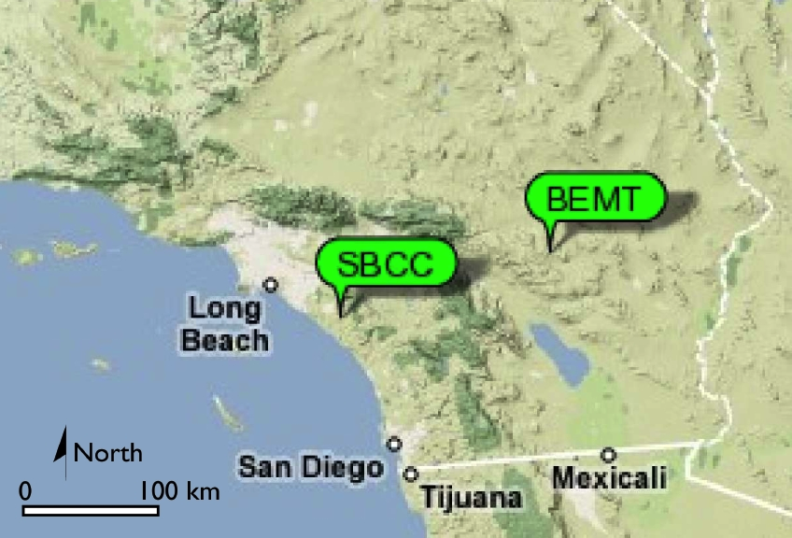
Where is that chunk of crust going?
Example: using GPS velocities to understand plate motions
Two PBO stations in California
Twenty-nine Palms,(BEMT)
Mission Viejo (SBCC)
Notes:
Southern California has numerous PBO stations, but let’s look at just two stations to see what we can learn from different velocities.
Background image from Google Maps.
Labels from UNAVCO http://www.unavco.org/education/resources/data-for-educators/data-for-educators.html

Slide 17
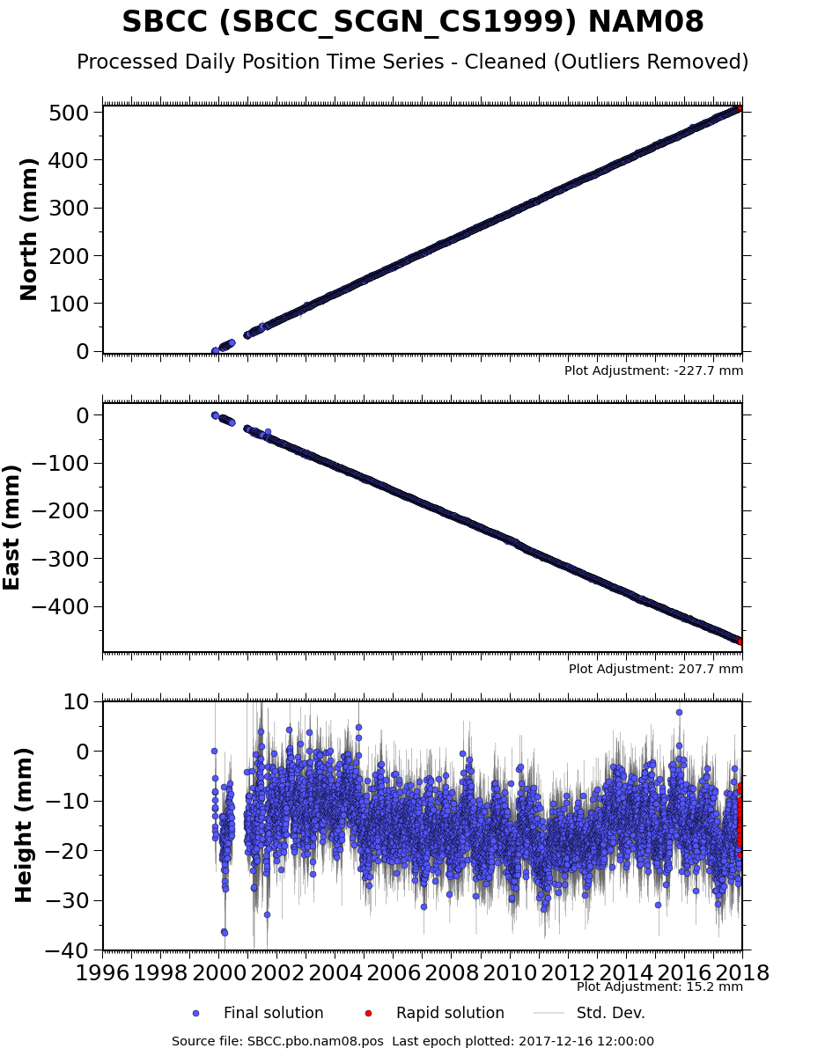
GPS time series data
Station position over time
  North-South
  East-West
  Up-Down
http://www.unavco.org/instrumentation/networks/status/pbo/overview/SBCC
Notes:
A variety of data products are available for each PBO station (http://www.unavco.org/instrumentation/networks/status/pbo/gps), but the most basic processed data is the station position over time = “time series”. The position is broken into the three orthogonal directions and set to an arbitrary zero datum. The most common reference frame for PBO data is North American 2008 (NAM08) reference grame which assumes that the eastern North America is not moving and all the motion in western North America is shown relative to this fixed stable east. For more on reference frames: https://www.unavco.org/software/visualization/GPS-Velocity-Viewer/GPS-Velocity-Viewer-frames.html
Vertical data are always much less accurate because of the angle to the satellite (if we could only put satellites below the surface of the Earth…vertical accuracy would improve)

Slide 18
GPS time series data
From the changing position velocity can be calculated using slope (rise-over-run)
26.8 mm/yr
510 mm
north
19 years
25.0 mm/yr
475 mm
west
~8 mm down
~0.4 mm/yr
http://www.unavco.org/instrumentation/networks/status/pbo/overview/SBCC

Slide 19
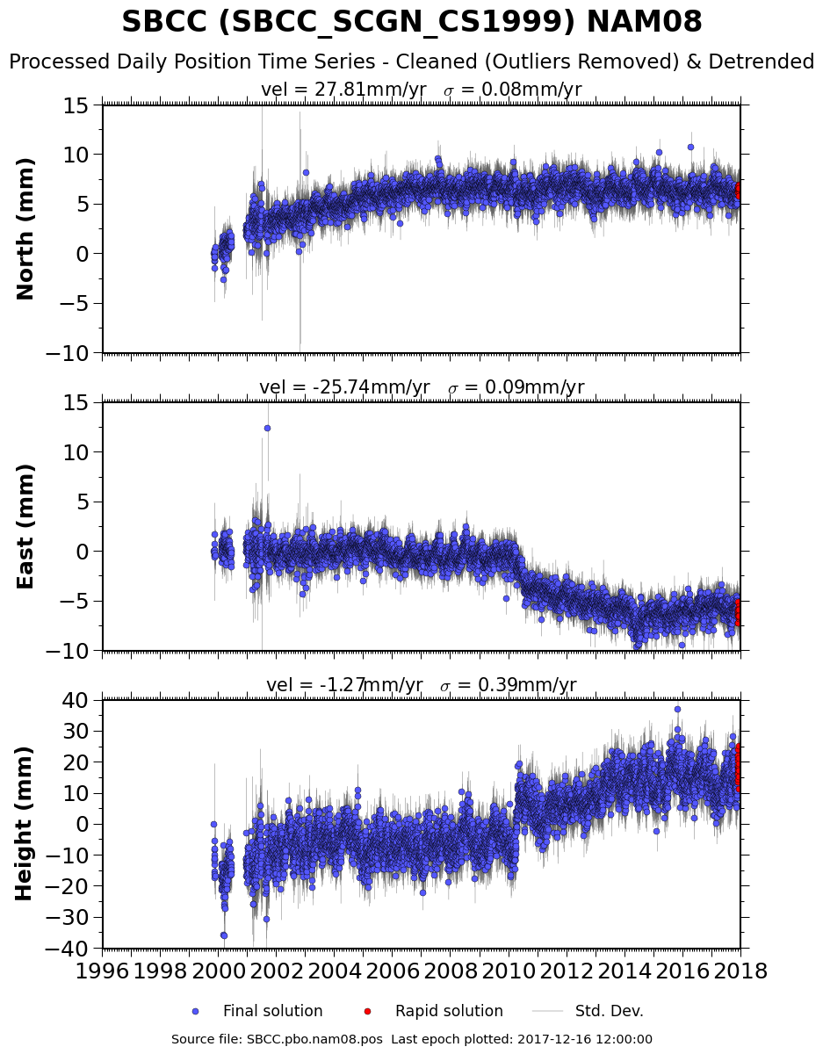
Detrended GPS time data
26.8 mm/yr
510 mm
north
19 years
25.0 mm/yr
475 mm
west
~8 mm down
~0.4 mm/yr
PBO also supplies “detrended” data with the average velocity subtracted out to observe other phenomena. In that case official velocity is given.
Notes:
Note that the velocity calculated by PBO from all the data points is quite similar to what we determined here in a back-of-envelope visual calculation.

Slide 20
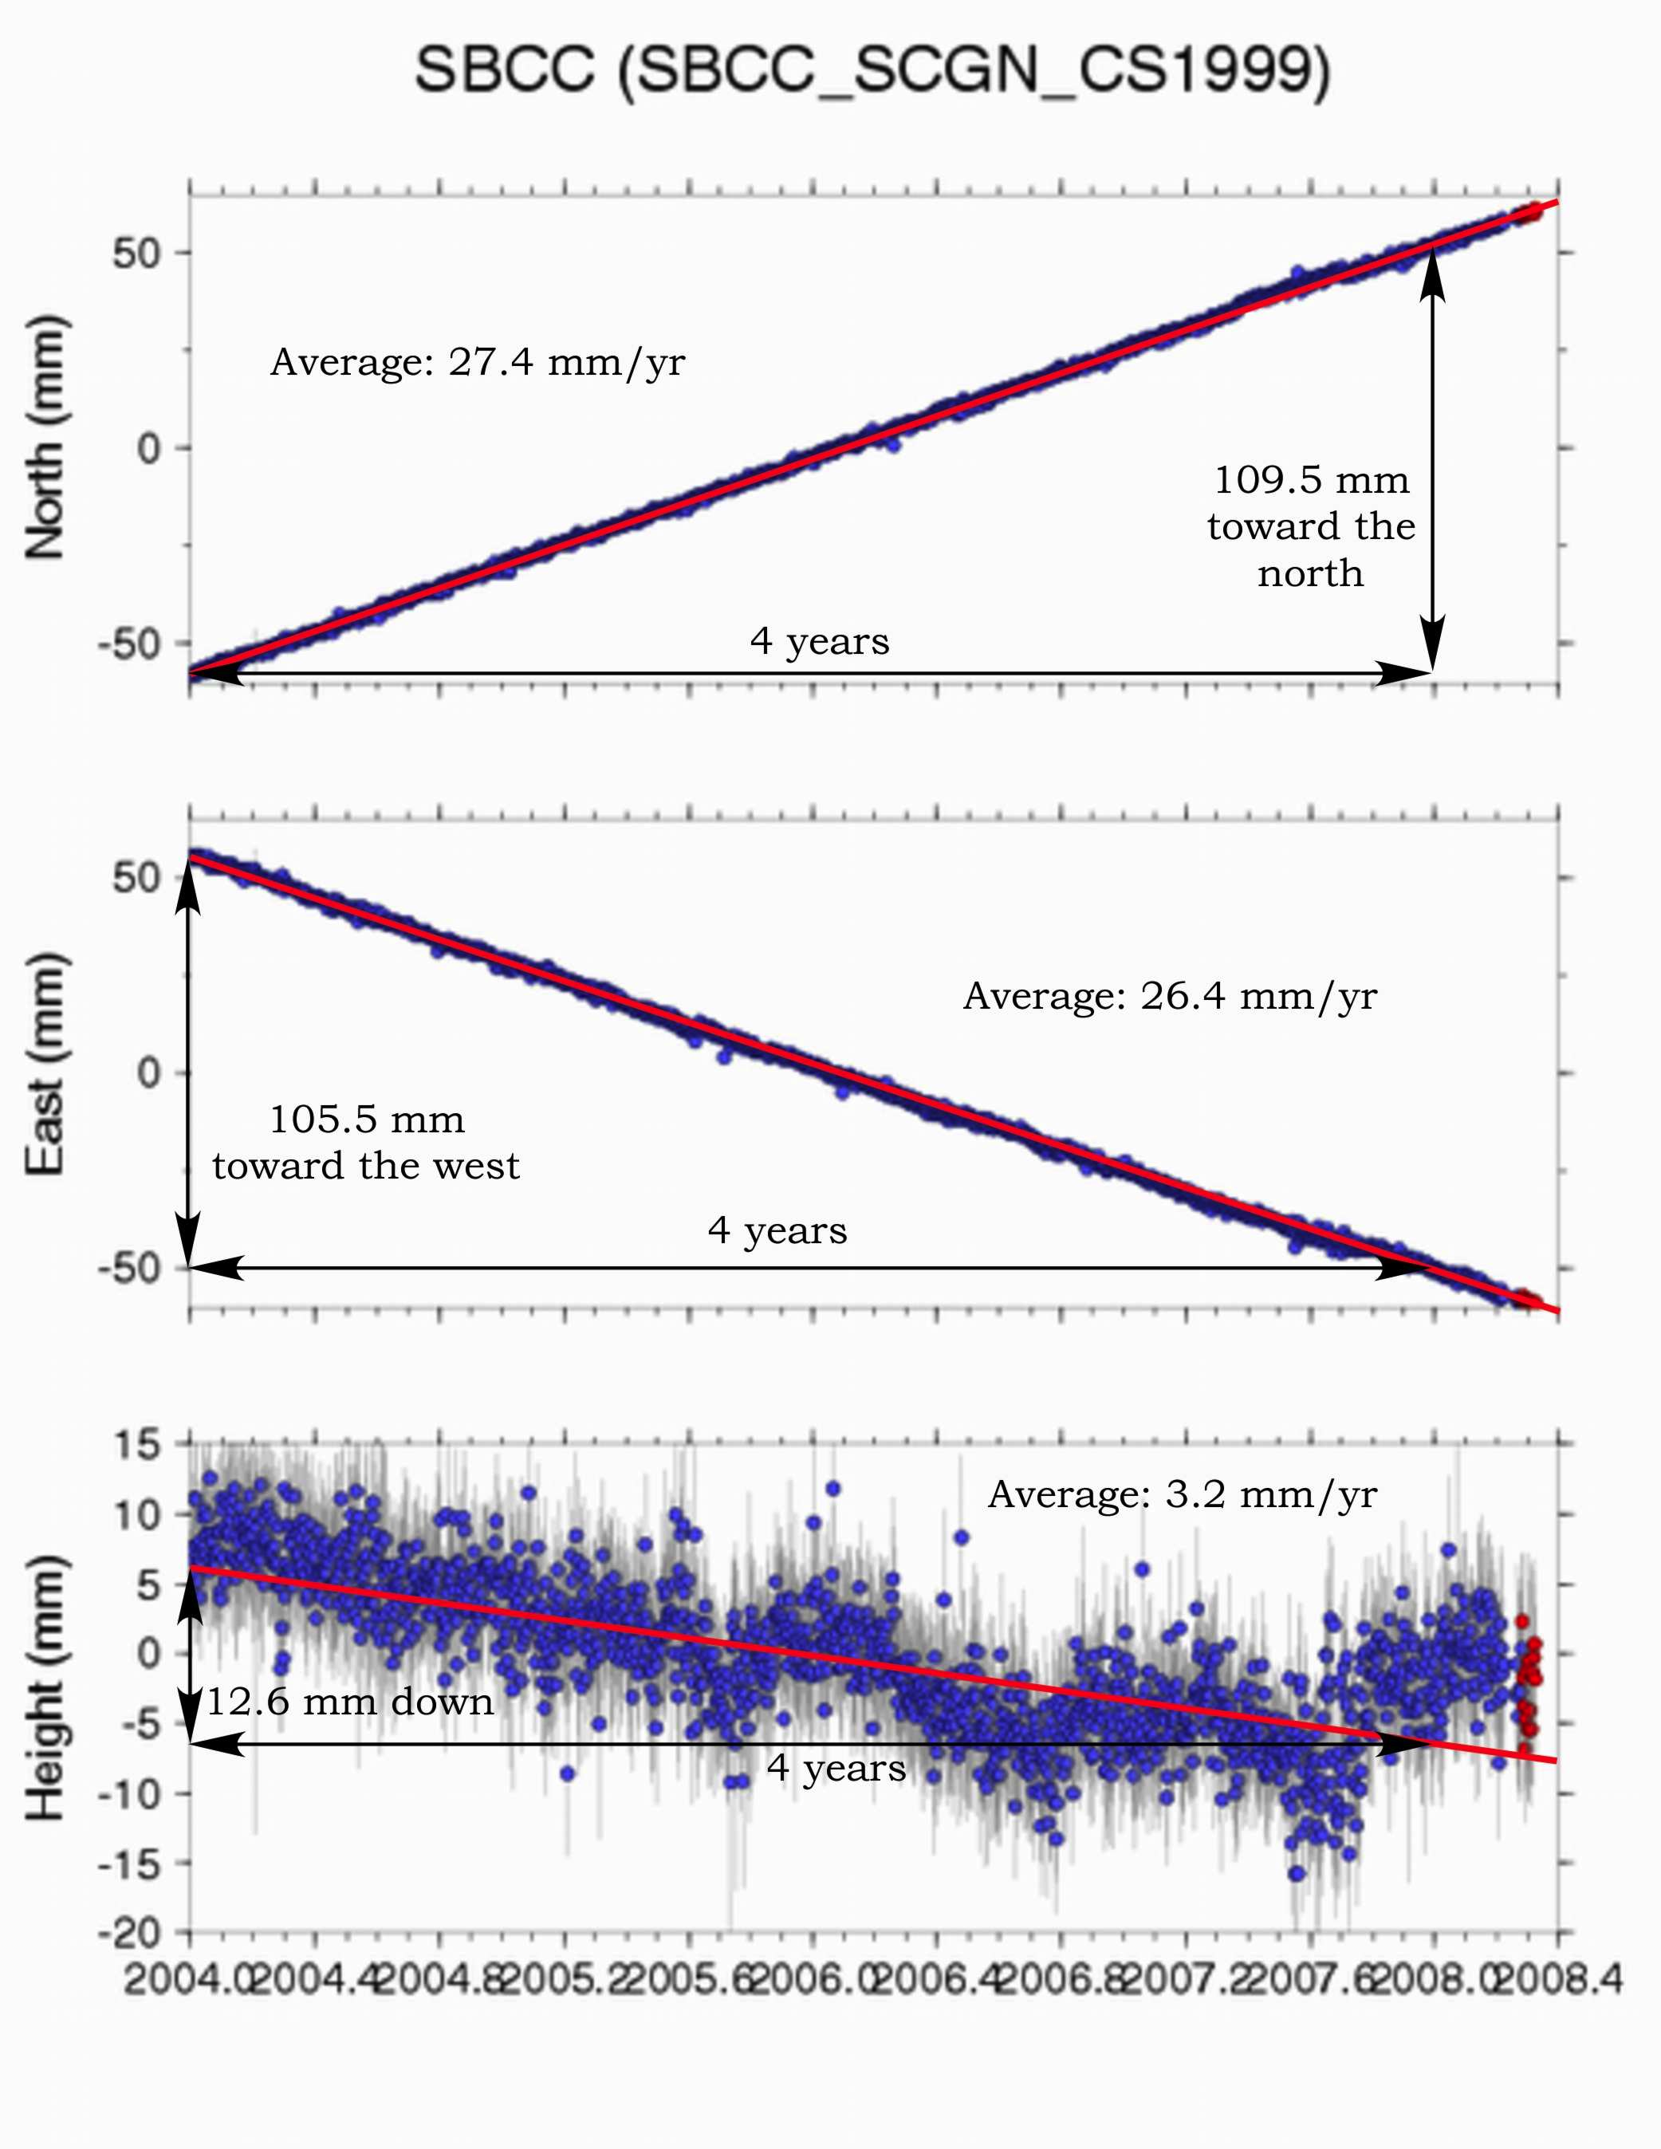
What is a site’s 3D speed?
Using the Pythagorean Theorem (high school math...),
Speed = (27.8)² + (25.7)² + (1.3)² = 37.9 mm/yr

Slide 21
What compass direction is the site moving?
Using the horizontal components of velocity,
and a bit of high-school trigonometry…
North
42.8°west of north
or
317.2°azimuth
θ = tan⁻¹(25.7/27.8) = 42.8°
27.8 mm/yr
θ
West
25.7 mm/yr

Slide 22
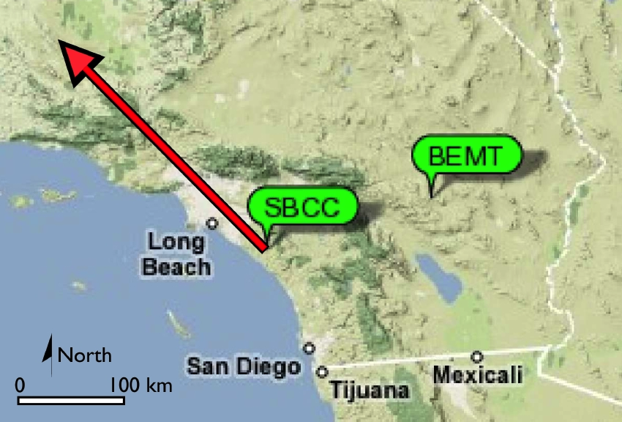
Map view of velocity
20 mm/yr
Notes:
Background image from Google Maps.
Labels from UNAVCO http://www.unavco.org/education/resources/data-for-educators/data-for-educators.html

Slide 23
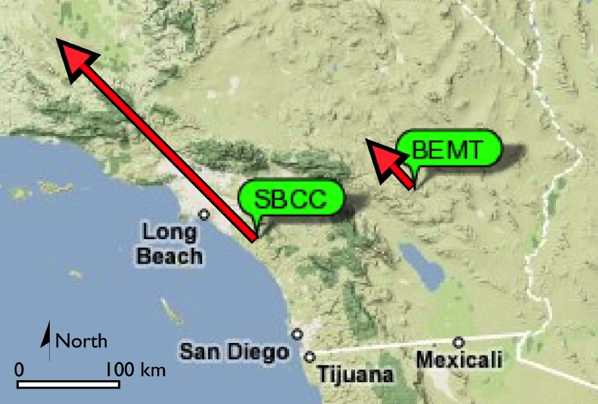
Two different velocities
Why the difference?
20 mm/yr
Same process yields much slower velocity at BEMT
Notes:
Ask your students to think about WHY there might be this great different in velocity between two nearby stations?

Slide 24
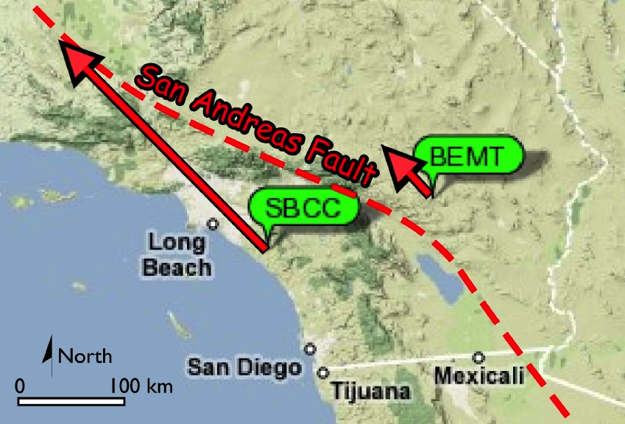
San Andreas Fault!
20 mm/yr
Notes:
The San Andreas Fault lies between these two stations so of course SBCC is moving much more quickly than BEMT

Slide 25
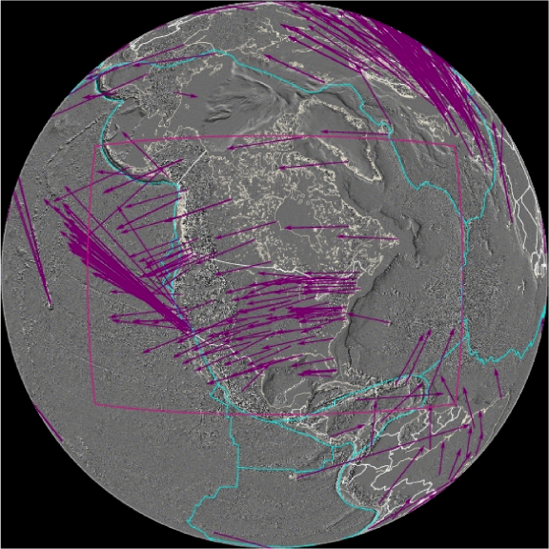
Reference Frames
All velocities are RELATIVE to a given reference frame
Velocities compared to International Terrestrial Reference Frame 2008 (IGS08 is GPS reference frame name)
Hot spot constellation as “stable”
Notes:
Compared to plate motions, hot spots are much more fixed, so a global reference frame has been defined in comparison to that hot spot constellation.
Image from UNAVCO

Slide 26
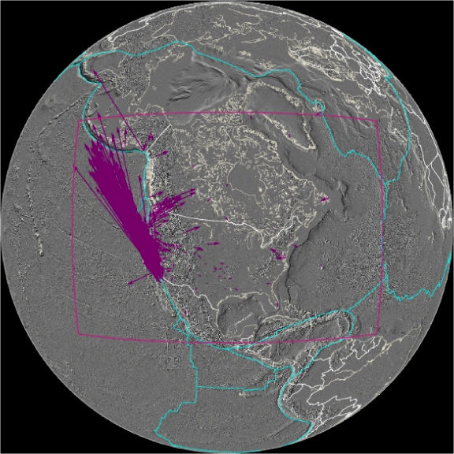
Reference Frames
All velocities are RELATIVE to a given reference frame
Velocities compared to stable North America (called NAM08 reference frame)
Eastern North America as “stable”
Notes:
More useful for most typically applications is to consider a local reference frame where movement in a deforming plate boundary is compared to the more stable, less-deforming region.
Image from UNAVCO
For more on reference frames see:
https://www.unavco.org/software/visualization/GPS-Velocity-Viewer/GPS-Velocity-Viewer-frames.html

